Slide 1
EmporiUm Sales Analysis
By Lily Wells

Slide 2
What questions were analyzed?
* Who are the territory managers for the sales territories assigned? What are the store IDs and cities for the stores in each assigned sales territory? ∗ What is monthly total revenue for in-store sales in each of the two sales territories, over the full period covered by the data? ∗ How would you rank the sales performance of each store in each sales territory? Which are the top-performing stores? ∗ Comparing the customer ID from the customer list data with the rewards ID from the sales data, who were the top customers in each sales territory? ∗ What is the number of transactions per month by product category in each assigned territory? What is total sales revenue per month by category? What might this tell you about the most popular products, and where could there be opportunity for growth? ∗ What is your recommendation for where to focus marketing attention in the next quarter?

Slide 3
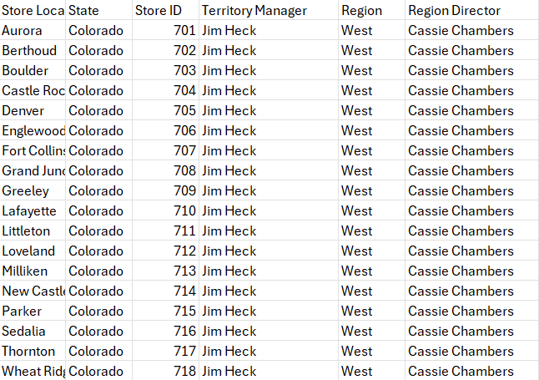
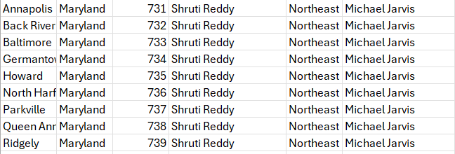
Who are the territory managers for the sales territories assigned? What are the store IDs and cities for the stores in each assigned sales territory?
My territory managers are Jim Heck for the West Colorado region, and Shruti Reddy for the Northeast Maryland region.

Slide 4
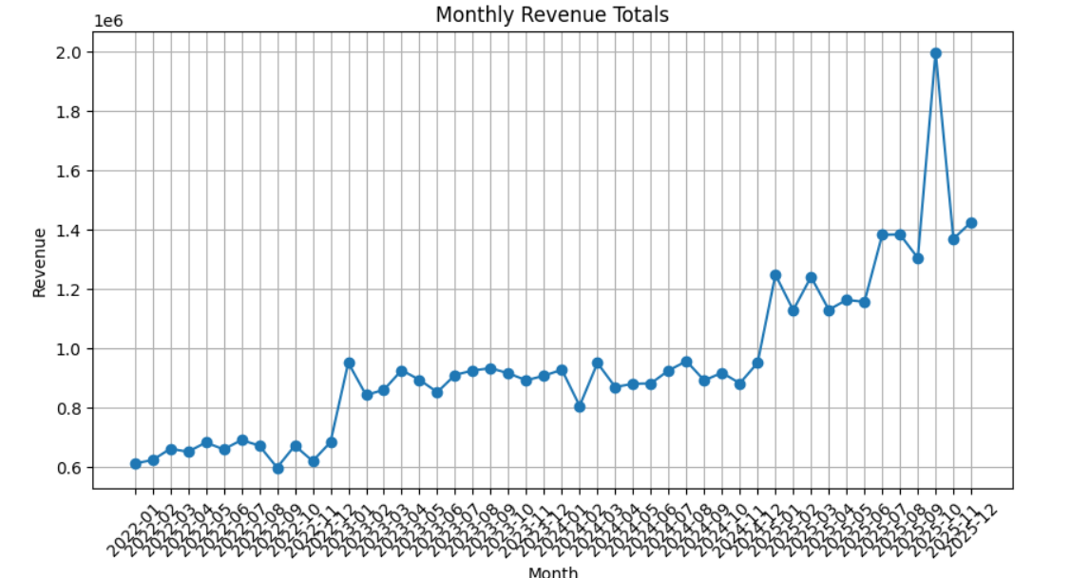
What is monthly total revenue for in-store sales in each of the two sales territories, over the full period covered by the data?

Slide 5
How would you rank the sales performance of each store in each sales territory? Which are the top-performing stores?
The highest performing store in Northeast Maryland is Store 737.
The highest performing store in West Colorado is Store 711.

Slide 6
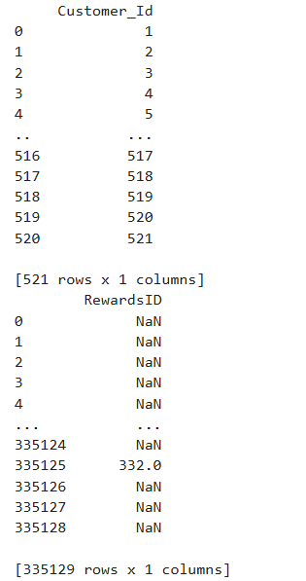
Comparing the customer ID from the customer list data with the rewards ID from the sales data, who were the top customers in each sales territory?
The top customers in the West Colorado region shopped at Store 702 with a reward id of 521 and a sale amount of 8.
The top customers in the Northeast Maryland region shopped at Store 731 with a reward id of 521 and a sale amount of 23.44.

Slide 7
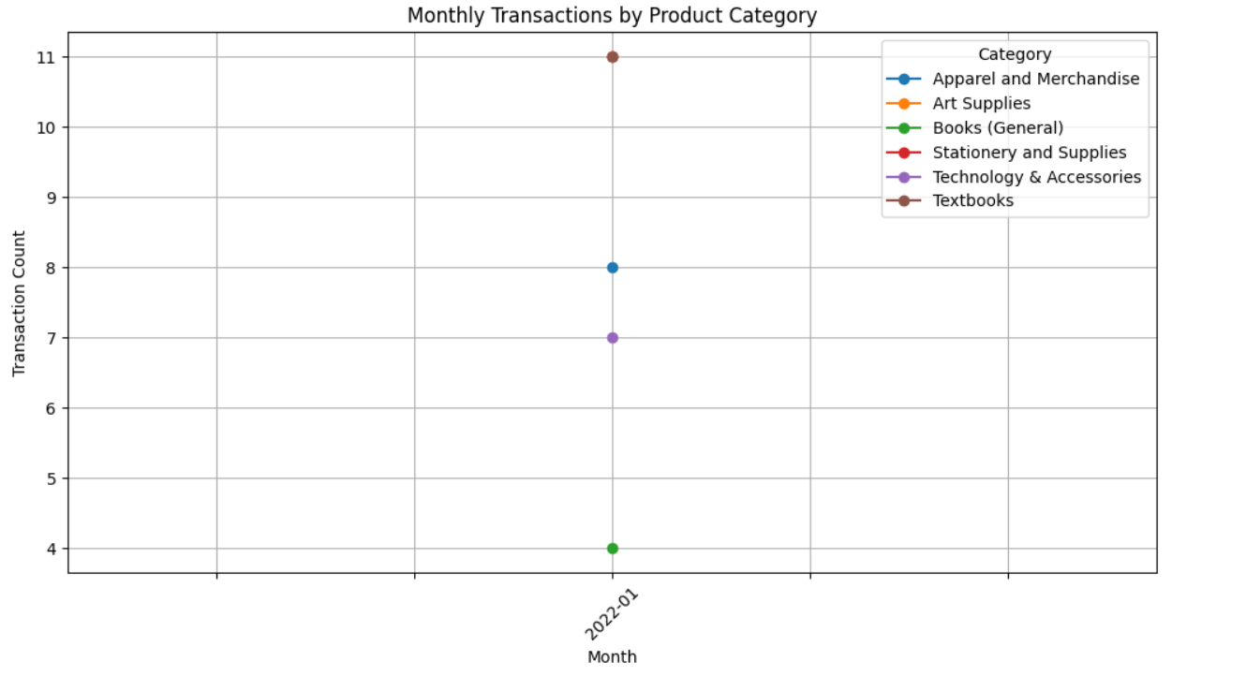
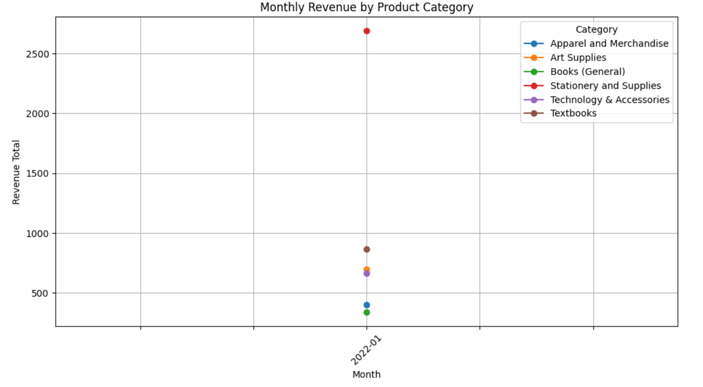
What is the number of transactions per month by product category in each assigned territory? What is total sales revenue per month by category? What might this tell you about the most popular products, and where could there be opportunity for growth?
There is room for growth in the general books category - perhaps due to disinterest in the genres provided?? I would recommend doing a survey to see why the general books category is performing so poorly compared to the other categories.

Slide 8
What is your recommendation for where to focus marketing attention in the next quarter?
I recommend focusing our efforts in textbook sales and stationary would be for the best. With the highest stores being 737 and 711 respectively, I believe we should make sure that those stores are supplied with textbooks and stationary tools to maximize customer profits.

Slide 9
Thank you for your time!

